Slide 1
Similar Question Siamese Networks -by Anuj,Rishabh,Snehashis & Yash

Slide 2
Contents
Motivation
Problem Description
Testing and Results
Preparation of Dataset
Model Architecture

Slide 3
Motivation
Due to low experts to questions ratio response time is high
The main challenge in this task is the lexico syntactic gap between the current and the previous questions.
Preliminary work done on Syntactic Similarity using Neural Network
Community Question Answering (cQA) like Quora, StackOverflow help obtain precise answers for questions.
To address this issue we can retrieve similar questions from archives

Slide 4
Problem Description
Retrieving semantically similar questions can be thought of as a classification problem with large number of categories.
In which standard did you study Trigonometry ?
 | Is Trigonometry considered high school or college level math?
 | Did you know Trigonometry is most important topic in Maths?
Why do people shop only after Thanksgiving?
How much money do people spend in shopping during Thanksgiving?
Can you tell me some Thanksgiving presents ?

Slide 5
Previous Approach
Classic Term Weighting Based Approaches: TF-IDF , BM25

Slide 6
Previous Approach
Classic Term Weighting Based Approaches: TF-IDF , BM25
Translation Models : The similarity function between questions is then defined as the probability of translating a given question into another.

Slide 7
Previous Approach
Classic Term Weighting Based Approaches: TF-IDF , BM25
Translation Models : The similarity function between questions is then defined as the probability of translating a given question into another.
Topic Models: The similarity between questions, is defined in the latent topic space discovered by the topic model.

Slide 8
Previous Approach
Classic Term Weighting Based Approaches: TF-IDF , BM25
Translation Models : The similarity function between questions is then defined as the probability of translating a given question into another.
Topic Models: The similarity between questions, is defined in the latent topic space discovered by the topic model.
Deep Learning Based Approaches: Deep use variants of neural network architectures to model question-question pair similarity.

Slide 9
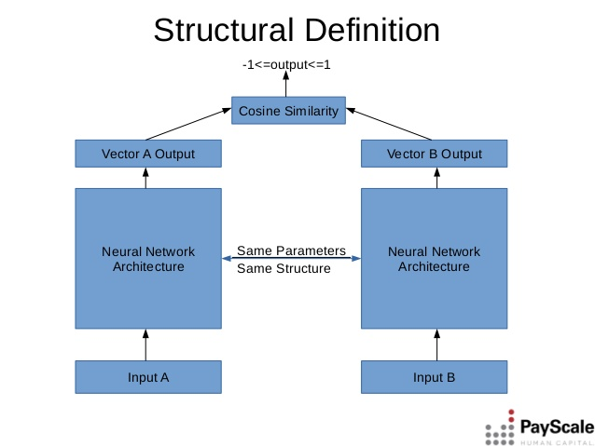
Model Description
Paper proposes a novel model SCQA based on Siamese Convolutional Neural Network which use shared parameters to learn the similarity metric between question-answer pairs in a cQA dataset.

Slide 10
Model Description
Paper proposes a novel model SCQA based on Siamese Convolutional Neural Network which use shared parameters to learn the similarity metric between question-answer pairs in a cQA dataset.
In SCQA, we overcome the non-availability of training data in the form of question question pairs by leveraging existing question-answer pairs from the cQA archives.

Slide 11
Model Description
Paper proposes a novel model SCQA based on Siamese Convolutional Neural Network which use shared parameters to learn the similarity metric between question-answer pairs in a cQA dataset.
In SCQA, we overcome the non-availability of training data in the form of question question pairs by leveraging existing question-answer pairs from the cQA archives.
We reduce the complexity by directly using character – level representations of question – answer pairs

Slide 12
Preparing Dataset
Need columns of Questions and Best Answer.
Dataset of 12 GB !! Too large to fit in memory(our memory)
Simple XML parser computes by loading into memory only few rows of data.
Parse one row at a time and get only relevant columns for each row(question and best answer)
Final data has 4.4 million question answer relevant pairs.(We are using subset of it)

Slide 13
Vectorization N-Grams
We are using NLTK for stemming and stop word removal to create Bag of Words for each document
Using Bag of Words we created 3 Hash of each Token and using NLTK vectorize to fit.
We get 30628 sized hash vector .
Pickle the hash vector as Dictionary that can be retrieved at time of Training.

Slide 14
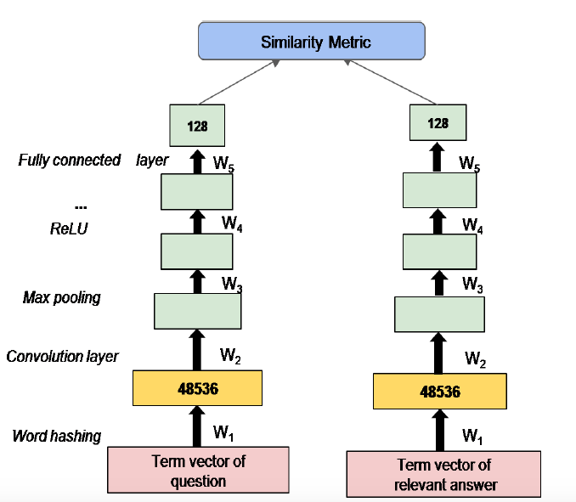

Model Design
Term Vector of Input in our case is 30682.
Convolution Layer Filter Parameters: Height = 1, Width = 10, Channels = 3 (Single Dimensional Sparse Network)
Max pooling Layer : Height = 1, Width = 100 ,Stride 100
Activation Layer : Relu
Fully Connected neurons : 128 x 307

Slide 15
Training
Each question and answer is converted to vector of 30682 as input to Siamese layer.
Get a subset of data for training. Construct batches from it.
Each batch is of size 100 questions with relevant answers to it and the same 100 question with irrelevant answer (any other answer).
Model is learned that maximizes distance between irrelevant pairs and minimizes distance between similar question pairs.
Loop through all data generating relevant and irrelevant pair batches in an epoch. Run for multiple epochs

Slide 16
Testing
Retrieve some random questions from the trained question answer pairs
Perform manual modifications in the questions syntactically and semantically.
Test our model on this modified questions set.
With respect to above questions we get about 66% good questions retrievals.
Apart from this we have also frame some random questions to retrieve relevant and close questions.

Slide 17
Thank You

